Slide 1
Graphical representations of models
Circular nodes | = Continuous variables
Square nodes | = Discrete variables
Unshaded nodes | = Unobserved variables
Shaded nodes | = Observed variables
Single bordered nodes | = deterministic variables
Double bordered nodes | = Stochastic variables
Graphical conventions
Assumptions
Additive dynamics
Only positive outcomes
No memory decay
Experiment
Decisions from experience
Full feedback
Models
CPT
LML (Lin. Utility)
LML (Iso. Utility)

Slide 2


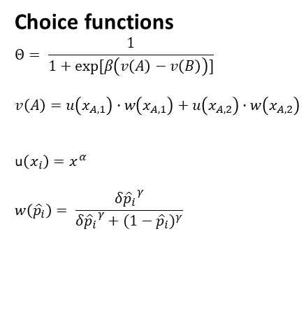













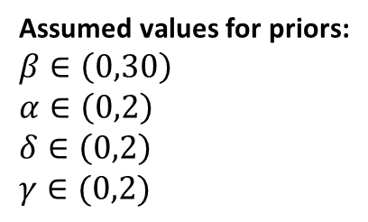
1) CPT Model
CPT model
CPT model
Hyperpriors
$μ_{γ}$
$$σ_{γ}$$
$μ_{δ}$
$$σ_{δ}$$
$μ_{α}$
$$σ_{α}$$
$μ_{β}$
$$σ_{β}$$
Choice functions
$$Θ= \frac{1}{1+exp⁡[β\left(v\left(A\right)−v\left(B\right)\right)]}$$
$$v\left(A\right)=u\left(x_{A,1}\right)∙w\left(x_{A,1}\right)+u\left(x_{A,2}\right)∙w\left(x_{A,2}\right)$$
u$\left(x_{i}\right)=x^{α}$
$$w\left({\hat{p}}_{i}\right)= \frac{{δ{\hat{p}}_{i}}^{γ}}{{δ{\hat{p}}_{i}}^{γ}+{(1−{\hat{p}}_{i})}^{γ}}$$
Priors
$$γ$$
$$δ$$
$$α$$
$$β$$
Choice
probabilities
$$Θ$$
Experimental factors
Q
Y
Gambles
Choices
$$Q=(x,\hat{p})$$
Y $\sim$ Binomial$(Θ,1))$
Priors
Assumed values for priors:
$$β∈\left(0,30\right)$$
$$α∈\left(0,2\right)$$
$$δ∈\left(0,2\right)$$
$$γ∈(0,2)$$
Hyperpriors
$μ_{β}\sim$Uniform(-2.3,3.4)
$$σ_{β}\sim Uniform\left(0.01,1.6\right)$$
$$μ_{α}\sim \text{Uniform}\left(\text{−2.3,0}\right)$$
$$σ_{α}\sim \text{Uniform}\text{(0.01,1.6)}$$
$$μ_{δ}\sim \text{Uniform}\left(\text{−2.3,0}\right)$$
$$σ_{δ}\sim \text{Uniform}\text{(0.01,1.6)}$$
$$μ_{γ}\sim \text{Uniform}\left(\text{−2.3,0}\right)$$
$$σ_{γ}\sim \text{Uniform}\text{(0.01,1.6)}$$
$β \sim$Lognormal$\left(μ_{β},σ_{β}\right)$
$α \sim$Lognormal$\left(μ_{α},σ_{α}\right)$
$δ \sim$Lognormal$\left(μ_{δ},σ_{δ}\right)$
$γ \sim$Lognormal$\left(μ_{γ},σ_{γ}\right)$

Slide 3


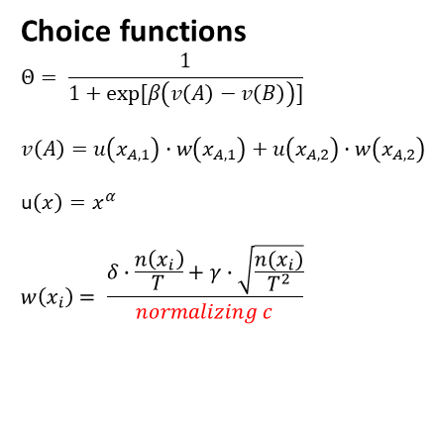


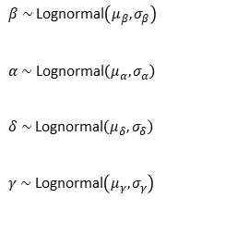
2) LML Model
LML model
Hyperpriors
$μ_{γ}$
$$σ_{γ}$$
$μ_{δ}$
$$σ_{δ}$$
$μ_{α}$
$$σ_{α}$$
$μ_{β}$
$$σ_{β}$$
Choice functions
$$Θ= \frac{1}{1+exp⁡[β\left(v\left(A\right)−v\left(B\right)\right)]}$$
$$v\left(A\right)=u\left(x_{A,1}\right)∙w\left(x_{A,1}\right)+u\left(x_{A,2}\right)∙w\left(x_{A,2}\right)$$
u$\left(x\right)=x^{α}$
$$w\left(x_{i}\right)= \frac{δ∙\frac{n\left(x_{i}\right)}{T}+γ∙\sqrt{\frac{n(x_{i})}{T^{2}}}}{normalizing c}$$
Priors
$$γ$$
$$δ$$
$$α$$
$$β$$
Choice
probabilities
$$Θ$$
Experimental factors
T
n(x)
Y
Trial
event
Choices
Y $\sim$ Binomial$(Θ,1))$
Hyperpriors
Priors
Assumed values for priors:
$$β∈\left(0,30\right)$$
$$α∈\left(0,2\right)$$
$$δ∈\left(0,2\right)$$
$$γ∈(0,2)$$
$μ_{β}\sim$Uniform(-2.3,3.4)
$$σ_{β}\sim Uniform\left(0.01,1.6\right)$$
$$μ_{α}\sim \text{Uniform}\left(\text{−2.3,0}\right)$$
$$σ_{α}\sim \text{Uniform}\text{(0.01,1.6)}$$
$$μ_{δ}\sim \text{Uniform}\left(\text{−2.3,0}\right)$$
$$σ_{δ}\sim \text{Uniform}\text{(0.01,1.6)}$$
$$μ_{γ}\sim \text{Uniform}\left(\text{−2.3,0}\right)$$
$$σ_{γ}\sim \text{Uniform}\text{(0.01,1.6)}$$
$β \sim$Lognormal$\left(μ_{β},σ_{β}\right)$
$α \sim$Lognormal$\left(μ_{α},σ_{α}\right)$
$δ \sim$Lognormal$\left(μ_{δ},σ_{δ}\right)$
$γ \sim$Lognormal$\left(μ_{γ},σ_{γ}\right)$

Slide 4













a
CPT-model
LML-model
Hyperpriors
$μ_{γ}$
$$σ_{γ}$$
$μ_{δ}$
$$σ_{δ}$$
$μ_{α}$
$$σ_{α}$$
$μ_{β}$
$$σ_{β}$$
$μ_{α}$
$$σ_{α}$$
$μ_{β}$
$$σ_{β}$$
Priors
$$γ$$
$$δ$$
$$α$$
$$β$$
$$α$$
$$β$$
Choice
probabilities
$$θ_{giτ}^{PT}$$
$$θ_{giτ}^{LML}$$
Model
indicators
$$Z_{i}$$
$$θ_{giτ}$$
Model
Indicator
Behavioral
response
$$Q_{giτ}$$
$$y_{giτ}$$
Gambles
Choices
b1
b2
c
d
Hyperpriors
Hyperpriors
Priors
Choice probabilities
$μ_{β}\sim$Uniform(-2.3,3.4)
$$σ_{β}\sim Uniform\left(0.01,1.6\right)$$
$$μ_{α}\sim \text{Uniform}\left(\text{−2.3,0}\right)$$
$$σ_{α}\sim \text{Uniform}\text{(0.01,1.6)}$$
$$μ_{δ}\sim \text{Uniform}\left(\text{−2.3,0}\right)$$
$$σ_{δ}\sim \text{Uniform}\text{(0.01,1.6)}$$
$$μ_{γ}\sim \text{Uniform}\left(\text{−2.3,0}\right)$$
$$σ_{γ}\sim \text{Uniform}\text{(0.01,1.6)}$$
$$θ\left({\left\langle x\right\rangle }^{Δ}\right)=\frac{1}{1+e^{−β{\left\langle x\right\rangle }^{Δ}}}$$
$μ_{β}\sim$Uniform(-2.3,3.4)
$$σ_{β}\sim Uniform\left(0.01,1.6\right)$$
$$μ_{α}\sim \text{Uniform}\left(\text{−2.3,0}\right)$$
$$σ_{α}\sim \text{Uniform}\text{(0.01,1.6)}$$
$$μ_{δ}\sim \text{Uniform}\left(\text{−2.3,0}\right)$$
$$σ_{δ}\sim \text{Uniform}\text{(0.01,1.6)}$$
$$μ_{γ}\sim \text{Uniform}\left(\text{−2.3,0}\right)$$
$$σ_{γ}\sim \text{Uniform}\text{(0.01,1.6)}$$
$β \sim$Lognormal$\left(μ_{β},σ_{β}\right)$
$α \sim$Lognormal$\left(μ_{α},σ_{α}\right)$
$δ \sim$Lognormal$\left(μ_{δ},σ_{δ}\right)$
$γ \sim$Lognormal$\left(μ_{γ},σ_{γ}\right)$
Both models
Model indicators
$$Z_{i} \sim \text{Categorical}\text{(}∙\text{)}$$
$$θ←\left\{\begin{aligned}θ^{CPT} if Z_{i}=1 \\ θ^{LML} if Z_{i}=2\end{aligned}\right.$$
Only CPT
Choice
$$y_{giτ} \sim Binomial(θ_{giτ},1)$$

